Slide 1
Estimation & Release Planning
A module in the
Agile Business Analysis
workshop
This work is licensed under the
Creative Commons Attribution-ShareAlike 4.0 International License.
To view a copy of this license, visit http://creativecommons.org/licenses/by-sa/4.0/.

Slide 2
Topics
Goals of an Inception
Analysts and Estimation
Analysis risk
Prioritizing stories
Analysis capacity

Slide 3
BA Artifacts
Inception
Iterations
Vision
Prioritized business objectives
Roles & personas
Scenarios
Narratives
Story maps
Right sized stories
Initial story list (Backlog)
Release plan with estimate
Functional test matrix
Notes:
A number of artifacts are created during inception. Typically only 2 during Iterations.
To help get to an initial estimate, release plan
The analyst is key to understanding what needs to be built functionally
There are a number of techniques used to obtain that understanding.
Are all these documents kept up to date? Not unless you discover a large piece missing. A whole scenario missing from the process flow. A role missing or completely off the mark definition.
The level of detail of the inception artifacts are at a much higher level than traditional methodologies.

Slide 4
Conditions of Satisfaction
Date Driven
Feature Driven
Story
Notes:
Before starting to plan a release it is important to know the criteria by which the project will be evaluated as a success or failure. That is, what are the desired targets or goals that the customer would like to achieve from each release. These targets are generally related to project scope, project schedule and resource goals.
Projects are generally either date-driven or feature-driven.
Date driven being that the project must be released by a given date, however the features of the project are negotiable.
Feature driven projects generally like to be completed as soon as possible but these projects consider the completion of a set of features to be more important.
Knowing these conditions upfront will help the project team, along with the customer, determine what needs to be developed to meet these outcomes/goals during a release.
Knowing this at the start of release planning will help the team when it comes to prioritising and selecting stories later in the process. Before this occurs the team needs to estimate the user stories first.
Low: 1min
High: 3min

Slide 5
Prioritized Business Objectives
Roles & Goals
“To Be” process model
Personae
Contextual Inquiry
Prioritized Master Story List
Staffing Model(s)
Identify story dependencies
Develop Training Strategy
Schedule
Determine Analysis Risk Factors
Develop Testing Strategy
Identify non estimate risk factors
Develop Deployment Strategy
Determine Planning Velocity
Define Initiation Activities
Technical design
Select tools
Release Plan with $ Estimates
Risk & Issues Log
Go/No Go Decision
Agile Readiness
Notes:
There is a lot that of information that we gather to get to a point where we can do Release Planning.
We’ve created a lot of artifacts to ultimately ……
[CLICK]
Produce the MSL
There is additional information we need to gain regarding stories
[CLICK]
Discuss the bubbles
And some technical things
[CLICK]
Discuss the bubbles
And some peripheral activities
[CLICK]
Discuss the bubbles
[CLICK]
Combined with a staffing model and a schedule
[CLICK]
We can create a Release plan
Risk & Issue Log
Go/No decision
Agile readiness – is there training for the team, cultural constraints, etc
Low: 1min
High: 2min

Slide 6
Effort Estimation
Notes:
Estimation happens continuously throughout the project.
Inception – higher level. Story cards.
During iterations – deeper level. Narratives.
1min

Slide 7
Analysts and Estimating
Unique #:
Title:
Priority:
Description:
As a <Role>
I want to <Goal>
So that <Value>
Estimate:
Complexity:
Completeness:
Volatility:
Notes:
How does the analyst participate in estimation?

Slide 8

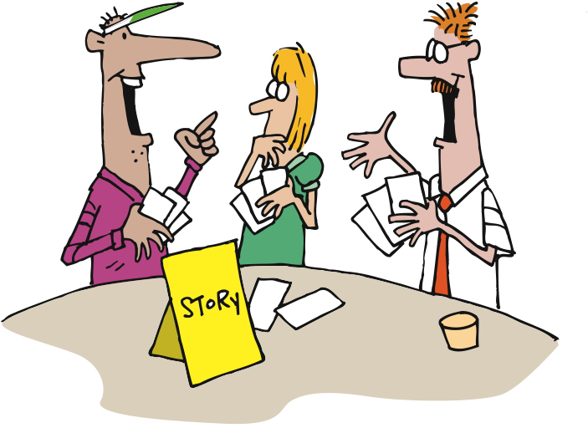
Notes:
Whether its inception level or iteration level, the process is the same.
Don’t forget the BA during estimation….
[CLICK]
The BA makes sure that stories are ready for the estimation session.
The BA presents the story to the developers for estimation.
Developers have questions about a story.
The BA answers them.
The questions may come up after the first throw.
Follow up with any unanswered questions
Also, use your facilitation skills to help negotiation or resolve conflicts
1min

Slide 9
Units of Measure
Story Point
Point is unitless
Influenced by the difficulty of the story
Relative effort is important
Notes:
Story points will then need to be translated to days for release planning.
Total story points / velocity = # of releases.
We demonstrated how to calculate planning velocity in the Fundamentals course.
Low: 1min
High: 2min

Slide 10
Units of Measure
Ideal days
How long something would take if it is all you work on, without any interruptions and everything you need is available
Ideal time vs. elapsed time
Notes:
Story points will then need to be translated to days for release planning.
Total story points / velocity = # of releases.
We demonstrated how to calculate planning velocity in the Fundamentals course.
Low: 1min
High: 2min

Slide 11
Analysis Risk
Notes:
1min

Slide 12
Analysis Risk
Unique #:
Title:
Priority:
Description:
As a <Role>
I want to <Goal>
So that <Value>
Estimate:
Complexity:
Completeness:
Volatility:
Notes:
1min

Slide 13
Analysis Risk Factors
What is Complexity, Completeness, Volatility?
Attributes
Not technical
Customer and analyst rate the stories
Customer and analyst articulate the assumptions and reasons for the ratings
Notes:
They are attributes of a story from an analysis perspective
They are not technical attributes
Customer and analyst rate the stories
Customer and analyst articulate the assumptions and reasons for the ratings
Allows the BA to adequately reflect the level of investigation done and remaining for each card.
Driven by time, availability for resources, other internal projects that will impact the story, etc
Developers understand the level of investigation done and estimate knowingly.
PMs apply factors to each rating and applies an analysis risk factor to each story.
Low: 1min
High: 2min

Slide 14



Complexity
Notes:
Complex - The domain surrounding the story is complex and therefore could be tricky to implement, e.g., Trading
Standard – The domain surrounding the story is normal but requires some learning to understand, e.g., Cash Management for a Retail chain
Simple – The domain surrounding the story is very simple, no real domain learning needed, e.g., a shopping website
Low: 1min
High: 2min

Slide 15



Completeness
Notes:
Complete – You have a good working knowledge of the story, its business context and details, etc. - even if the narrative isn't completed yet
Incomplete – You have discussed some / most of the story's requirements - though some are still
Unknown – You know almost nothing about the requirement and really need to explore it further
Low: 1min
High: 2min

Slide 16


Volatility
Notes:
High – The story’s major requirements are likely to change (big stories with high volatility are good candidates for analysis spikes)
Medium – There are unresolved issues but in general it is clear what the story will do. Look for key words like "usually" or "most of the time") (estimate will be affected, but not in a scary way)
Low – The requirements are relatively stable you don't anticipate a lot of changes for the story (shouldn’t affect the estimate too much)
Low: 1min High: 2min

Slide 17
Calculating Analysis Risk
Updating the MSL
The Calculated Estimated Risk column shows the analysis risk for the story. This will affect the development estimates.
Notes:
Low: 1min
High: 3min
17

Slide 18
Analysis Risk Factors
Pick 3 stories from the MSL and set the CCV ratings for each story.
Be prepared to discuss your reasoning.

Slide 19
Discussion
What value can you see in assigning these ratings to a story card?
What are the cautions you might exercise around assigning these ratings?
Notes:
We'd be reminded of the incompleteness of particular stories
Where incomplete, we'd create assumptions along a more standard line so that assumptions could be managed more easily across stories
It gives the Project Manager a better understanding of how well the story is understood
It would make Business Analysts with less experience more confident that they have investigated at an appropriate level
But note, this is a very HEAVY activity to apply to all story cards in a large project—should perhaps be done at epic or feature level, not for each individual card.
Low: 5min
High: 8min

Slide 20
Prioritizing Stories
Notes:
1min

Slide 21
Prioritizing Stories
Unique #:
Title:
Priority:
Description:
As a <Role>
I want to <Goal>
So that <Value>
Complexity:
Completeness:
Volatility:
Estimate:
Notes:
There are many techniques used to prioritize the stories
Use the quantifiable Business Objectives
The Principle of Relative priority
According to Fabio Pereira: All the decisions about item priority have to involve other items which are being traded in favor of the most important one(s). There is no absolute priority, only relative to other items.
Prioritize difficult technical issues
Prioritize complex analysis items
Games you can play – Luke Hohman
Buy a feature
Low: 2min
High: 4min

Slide 22
Prioritization
Story mapping/sequencing
Business value – Economy vs luxury
Epics
MoSCoW
Must have, Should have, Could have, Won’t have
Always used, seldom used ratings
Dependencies
Notes:
Low: 2min
High: 4min

Slide 23
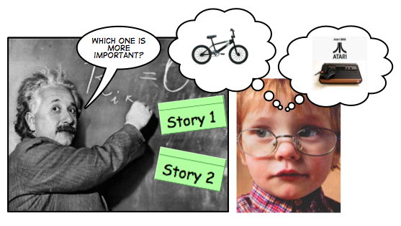
Relative Priority
All the decisions about item priority have to involve other items which are being traded in favor of the most important one(s). There is no absolute priority, only relative to other items.
http://fabiopereira.me/blog/2009/06/29/principle-of-relative-priority/
Notes:
There are many techniques used to prioritize the stories
Use the quantifiable Business Objectives
The Principle of Relative priority
According to Fabio Pereira: All the decisions about item priority have to involve other items which are being traded in favor of the most important one(s). There is no absolute priority, only relative to other items.
Prioritize difficult technical issues
Prioritize complex analysis items
Games you can play – Luke Hohman
Buy a feature
Low: 1min
High: 3min
----------------------------------------------------------------------------------
Once we’ve decided how to organize our work, we then have to decide which things to do when. One way to approach this is The Principle of Relative Priority:
According to Fabio Pereira: All the decisions about item priority have to involve other items which are being traded in favor of the most important one(s). There is no absolute priority, only relative to other items.
This means that – just like estimating stories, which we’re going to get to shortly – our goal is to understand our choices, and then rank order them such that every story is more or less important than every other story. Along the way, we must also understand that these priorities can – and likely should – change during the life of the project, due to changes in the business environment.

Slide 24
Prioritizing during planning
High
Avoid
Do first
High risk
low value
High risk high value
Low risk low value
Low risk high value
Also consider:
Story size: bigger stories early
Parallelizability of stories: can we run X and Y at the same time?
Story dependencies: A before B
Risk
Avoid.
Do first.
Do last
Do second
Do last.
Do second.
Low
Value
High
Notes:
“Value” can come in many shapes and sizes:
IRACIS (Improved Revenue, Avoid Costs, Improve Service)
Regulatory compliance
Customer retention
Increased productivity (e.g., reduced development costs)
The amount and significance of learning and new knowledge created
The amount of risk removed
Low: 2min
High: 5min

Slide 25
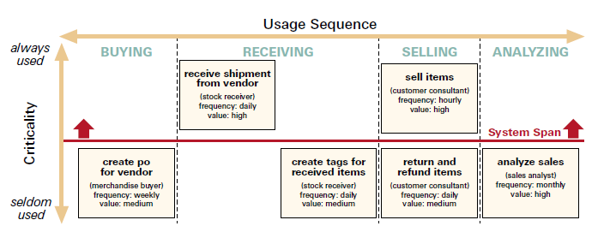
Span Planning
http://www.agileproductdesign.com/writing/how_you_slice_it.pdf
Notes:
Jeff Patton
Lay out the stories horizontally in process sequence as we did in Story Mapping
Place them vertically by criticality. Always used vs seldom used. Another way to assign Priority!
Slice them horizontally by release
Goal is to get a full path through the system in a release.
Break down by
Product line
Customer base
Transaction type
Small example vs 300 – 400 stories.
Do a pre-grouping first of high level functional areas or flavors or variations
Need lots of space
Patton, Poppendicks
Usage/sequence diagram
Cut by role
Cut by span – release. The minimum amount of features to be usable to the business.
1st release may not support all roles.
1st release may not be a public release.
Testers can evaluating the flow of the system.
Techs can start evaluating the architecture and scalability of the system
Low: 3min
High: 10min

Slide 26
Span Planning
Using your story map, move the stories vertically using the criticality rating.
Notes:
Low: 5min
High: 15min

Slide 27

Debrief
What went well?
What key learnings did you take from that exercise?
What still puzzles you?
Notes:
Debrief:
What went well?
What key learning's did you take from that exercise?
What still puzzles you?
Low: 5min
High: 15min

Slide 28
Capacity Planning
Notes:
How do you estimate the number of Analysts you need on a team?
1min

Slide 29



Capacity Planning
Notes:
During release planning we determine the number of resources needed on the project.
Ratio of 1 BA: 2 Dev pairs is standard. BTW - Same for QA
This has historically been the case in TW last 10 years of agile projects.
Ruby projects (OVE) have shown a need for 1 BA: 1 Dev pair as the developers move much quicker due to the language.
Low: 1min
High: 2min

Slide 30
Review
Goals of an Inception
Analysts and Estimation
Analysis risk
Prioritizing stories
Analysis capacity

Slide 31
BA Artifacts
Inception
Iterations
Vision
Prioritized business objectives
Roles & personas
Scenarios
Narratives
Story maps
Right sized stories
Initial story list (Backlog)
Release plan with estimate
Functional test matrix
Notes:
A number of artifacts are created during inception. Typically only 2 during Iterations.
To help get to an initial estimate, release plan
The analyst is key to understanding what needs to be built functionally
There are a number of techniques used to obtain that understanding.
Are all these documents kept up to date? Not unless you discover a large piece missing. A whole scenario missing from the process flow. A role missing or completely off the mark definition.
The level of detail of the inception artifacts are at a much higher level than traditional methodologies.

Slide 32
Questions?

